Slide 1
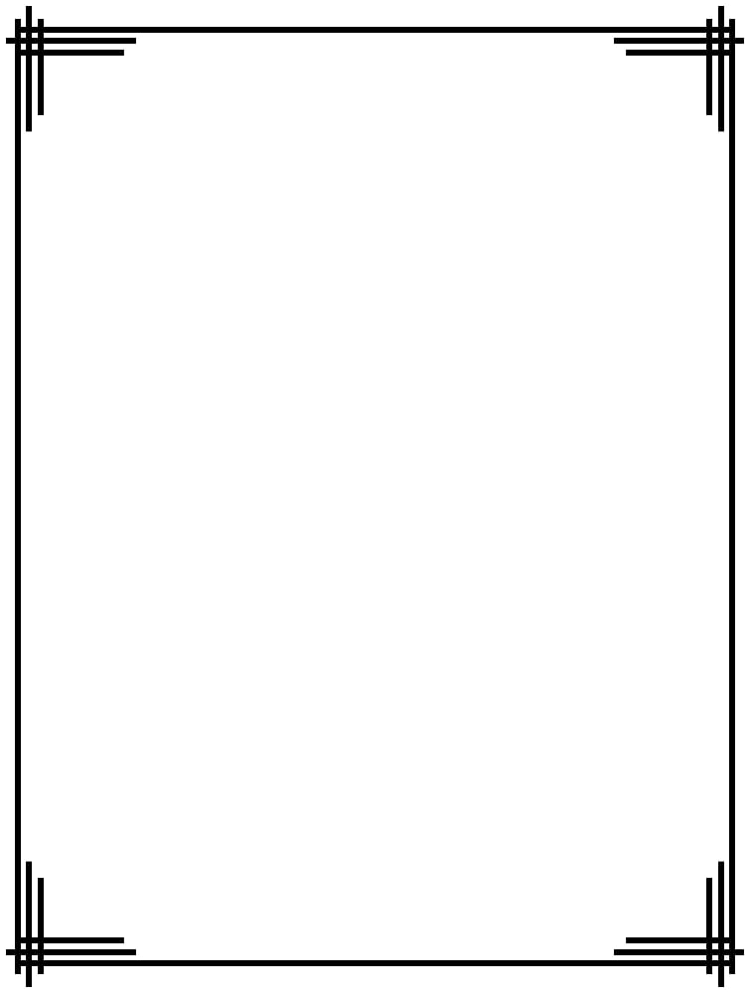


A CENTER FOR INTER-DISCIPLINARY RESEARCH
2018-19
IMAGE EDITING LIBRARY
_______________________
SUPERVISED BY
MR.YELMA CHETAN REDDY
GOKARAJU RANGARAJU
INSTITUTE OF ENGINEERING AND TECHNOLOGY
AUTONOMOUS

Slide 2
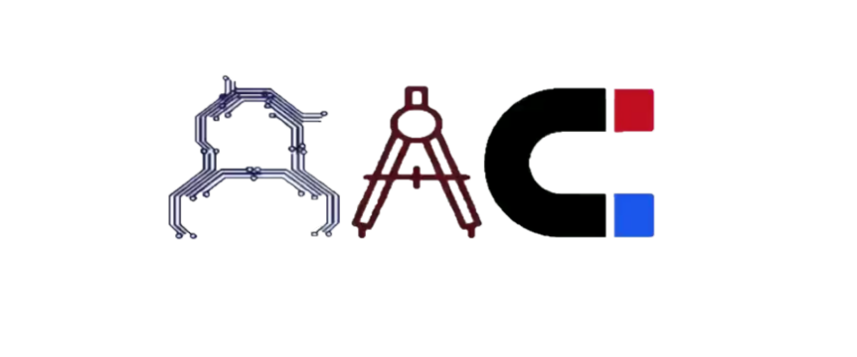
Advanced Academic Center
( A Center For Inter-Discilinary Research )
This is to certify that the project titled
“ ------------------------------------’’
is a bonafide work carried out by the following students in partial fulfilment of the requirements for Advanced Academic Center intern, submitted to the chair, AAC during the academic year
2018-2019
Image Editing Library
NAME | ROLL NO. | BRANCH
MALI ARJUN REDDY | 18241A1294 | IT
UMAKANTH SAHU | 18241A1259 | IT
MISBAH SULTANA | 18241A05X3 | CSE

Slide 3
NAME | ROLL N0 | BRANCH
SHREYA PYATA | 18241A0544 | CSE
KALUVALA SAI PRATHEEKA | 18241A0517 | CSE
LANKIREDDY SRI LIKHITHA | 18241A0525 | CSE
VANAGANTI VAMSHI KRISHNA | 18241A0556 | CSE
SANDANABOINA VIKITHA | 18241A05A7 | CSE
REETHIKA RAPOLU | 18241A05A5 | CSE
BHARGAVI LELLA | 18241A0590 | CSE
SREEJA KOMPELLY | 18241A0522 | CSE
TELUGU AKILA | 18241A0555 | CSE
This work was not submitted or published earlier for any study
Mr.Yelma Chetan Reddy
Dr.B.R.K.Reddy
Program Coordinator
Dr.Ramamurthy Suri
Associate Dean,AAC
Project Supervisor

Slide 4


ACKNOWLEDGEMENTS
We express our deep sense of gratitude to our respected Director , Gokaraju Rangaraju Institute of Engineering and Technology for the valuable guidance and for permitting us to carry out this project.
With immense pleasure, we record our deep sense of gratitude to our respected principal, for permitting us to carry out this project.
We are thankful to Associate Dean ,Advance Academic Centre for providing us appropriate ecosystem required for the project to complete.
We are thankful to our project supervisor who spared valuable time for us and influence novel ideas to guide us. I am indebted to all the above without whom I would not have concluded the project.

Slide 5
INTRODUCTION
The collection of operations in python which are used to edit an image is been presented in this project. This paper presents a library for image editing based on image data-types.
It includes image editor features such as cropping, translating an image, etc. to enhance the image suitable to our requirement this is being used.
Raster images are stored in a computer in the form of a pixels. These pixels contain the image’s color and brightness information. Image editor library can alter image, color, size as a group or individually, by the algorithms and python based programs within the library.
SYNOPSIS
The main requirement of this project is we have many operations used to alter image but all the operations clubbed and made into a library is not seen. Editing is another way to get across what we try to capture when we take the photo. That’s because what we capture in camera sometimes does not accurately reflect that moment. Because we might not get our settings quite right in camera, and reach expectations of the photographer. We here exhibiting many programs to edit an image in different ways.
ABSTRACT
IMAGE EDITING LIBRARY is a mathematically programming based project whose main aim is to provide compact, and comfortable operations to alter images. In this, python programming language is used to complete the operations on an image. An image is taken, cropped, translated, resized, rotated or based on the programs, and an efficient amount of mathematics behind them.

Slide 6
STRAIGHT LINE
Introduction:
In this context we are going to draw a straight line by taking the 2 points as inputs. Though we have a particular command in OpenCV to draw a straight line, we are going to draw a line without using those commands.
By using some mathematical formulas like by calculating slope of the required line, we are going to implement this task.
Mathematics behind the code:
Mathematics required for drawing a straight line is very simple and basic math. Every one of us is familiar to co-ordinate system. Any point in co- ordinate system will have 2 ordinates. X-ordinate is known as 'abscissa’ and Y-ordinate is known as 'ordinate'.
If we consider any 2 points like (x1,y1)and(x2,y2);x1 and x2 represent X-ordinates whereas y1 and y2 represent Y-ordinates.
Slope of any straight line is given by
M=(y2-y1)/(x2-x1)
General equation of any straight line is given by
Y=m*x+ c
Where,
y-is the y coordinate and x-is the x coordinate
c-is the y coordinate where the line cuts the Y-axis
m-is the slope of straight line
Since the line passes through 2 points, by considering any one of the points
C=y1-m*x1
By using this we will calculate C value

Slide 7
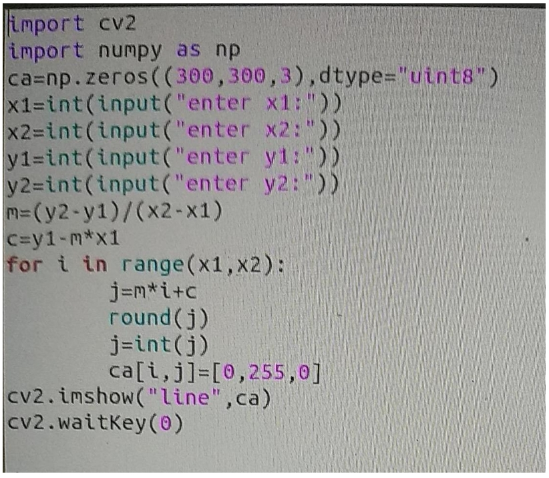
Code Explanation:
Basic libraries for image processing like CV2 and numpy are imported.
Then a black image of 300*300 pixels is created.
Then by using input command, inputs are taken i.e. The starting and ending coordinates for the line are taken
In order to draw the line, slope and the point where it cuts the Y-axis are calculated by using the formulas.

Slide 8
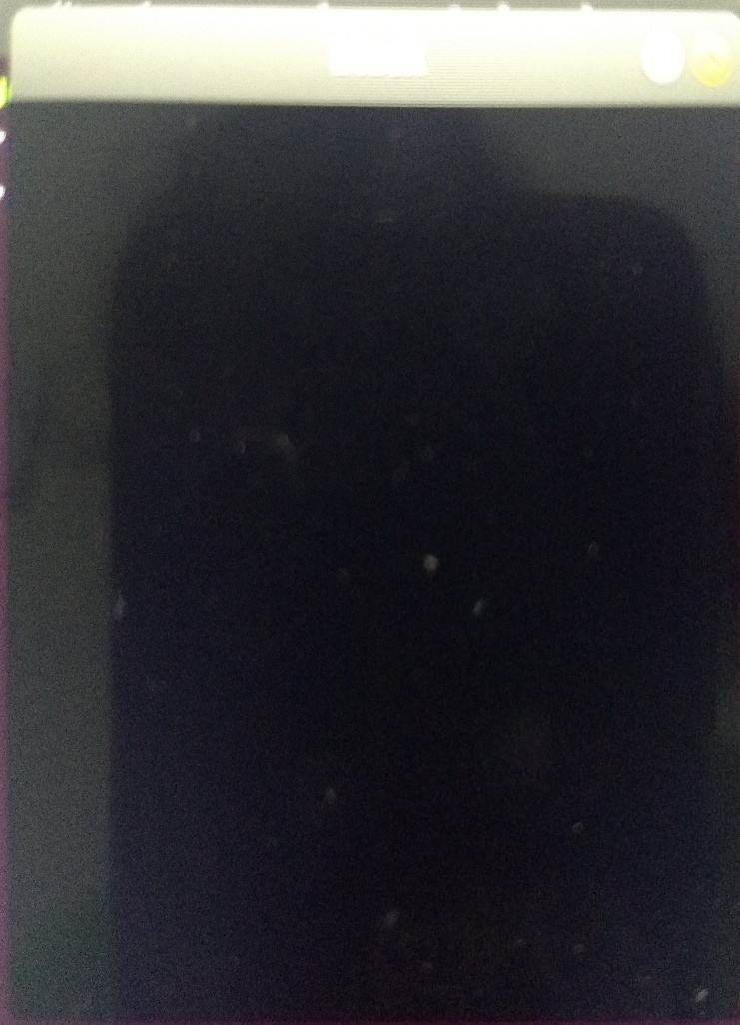
draw To the straight line we use 'for loop'.
For each value of x, the corresponding y value is calculated.
If the corresponding y value is a decimal number, then 'round' command is used to truncate the decimals.
Again 'int' command is used to convert it into an integer.
Now, each coordinate on the same straight line and between the 2 points is assigned a color (for example green)by using the command
Image[i,j]=[0,255,0]
imshow(“image”, image) command is used for displaying the final image.

Slide 9
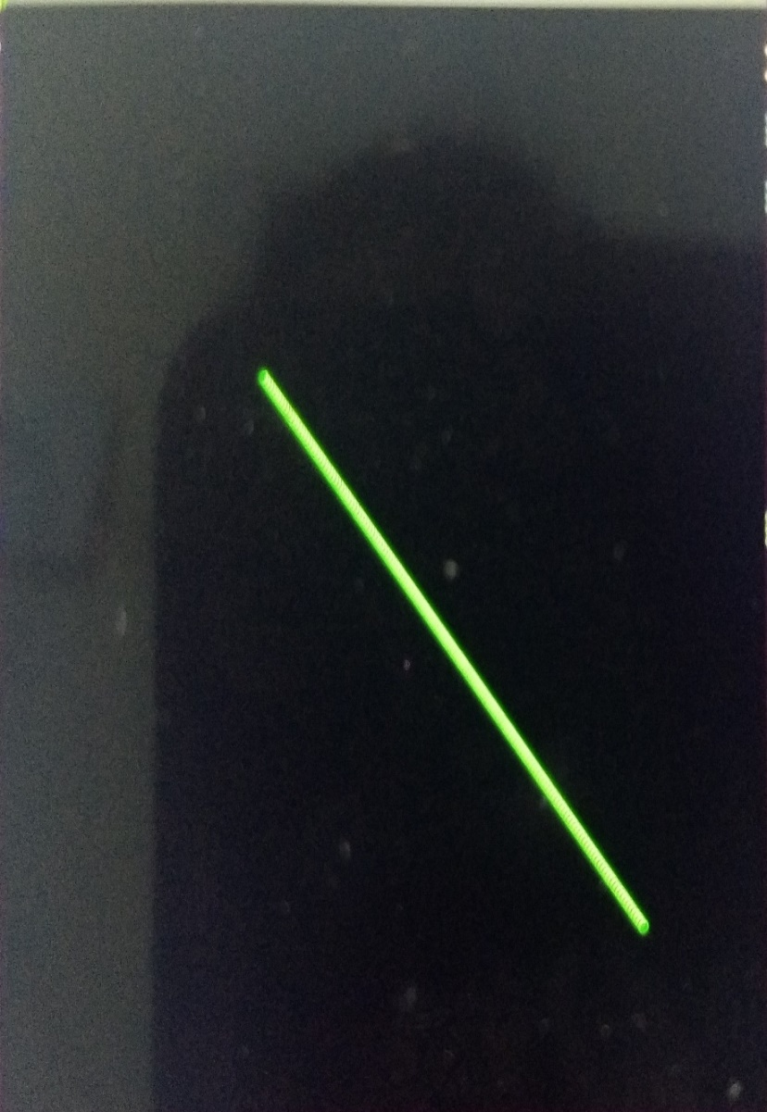
Output:
Suppose if the inputs are given as
x1=125
x2=250
y1=125
y2=25
then the output image will be
At the starting of our task, we faced some indentation errors while using for loop. Rather than that, we didn’t face any problems or errors.

Slide 10
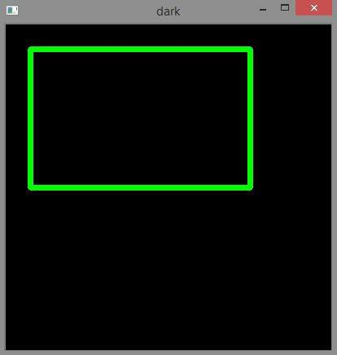
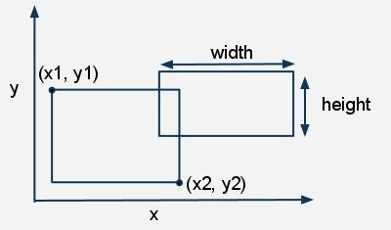
RECTANGLE
Introduction:
The rectangle can be drawn by taking the points as inputs from the users. The python has specific command to trace a rectangle .But we can even draw a rectangle without using that and that’s what we did in our program.
This is what we drew using our code. By using some mathematics and python commands we wrote the code.
Mathematics Behind The Code:
The mathematics behind the code is all about the co-ordinate system. To understand the code or to trace the code for drawing the rectangle we need to know about the basics of co-ordinate system

Slide 11
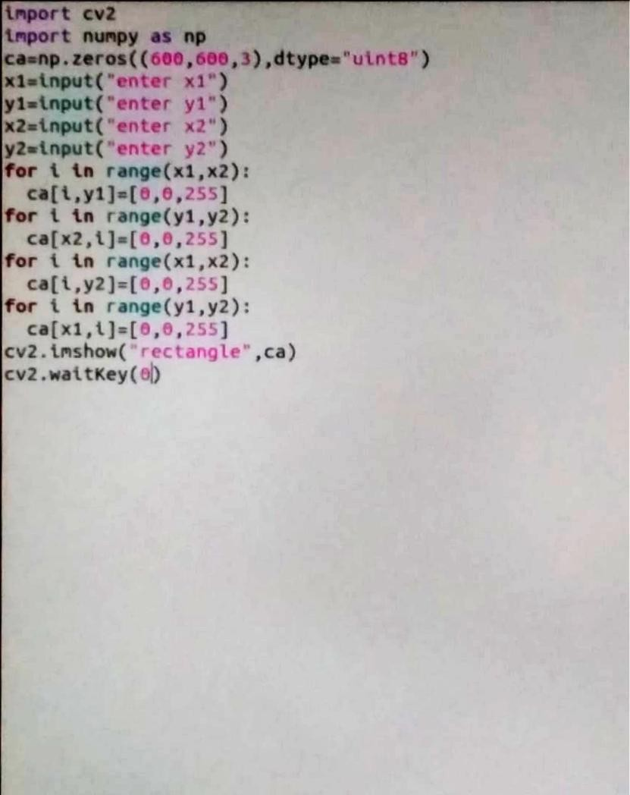
In the line parallel to the x-axis ,the X values changes but the y values doesn’t change.
In the line parallel to the y-axis ,the y values changes and X values remains same .
Based on the above two points we wrote the code. This is the basic math we used in the code.

Slide 12
Explanation of code:
Import commands are used to import the libraries like CV2 and numpy. Next we take the 2 points as inputs from the users.
Two points are necessary to draw a rectangle. we create a black image by using the numpy.zeros command which makes every value in the matrix to zero and provide a black screen of given dimensions.
The rectangle consists of 4 straight lines ,so we write the 4 for loops to draw each line .Here we need to be careful about the points.
Imshow command is used to show the rectangle image on the black image we created.
Errors:
At first we got indentation errors .Despite of that we didn’t face much errors.

Slide 13
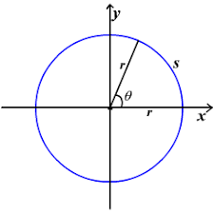
CIRCLE
Introduction
Here, we give colors to a circle both in and outside of the background using Centre, radius and a point on the circumference.
Explanation:
Libraries used are cv2,math,numpy.
To use mathematical functions we use math library.
numpy provides fast and efficient operations on arrays
of homogeneous data.
The append( ) method adds an item to the end of the list. round( ) function is used to round of the floating point value to an integer. imshow( ) function is used to display an image. waitKey( ) function is used to introduce a delay of ‘n’ milliseconds and used for keyboard input from the user.
Math Behind The Code:
A circle is the locus of all points equidistant from a central point.
We consider locus of the circle by using mathematical expressions for both X,Y co-ordinates.
X=x+radius*cos(angle)
Y=y+radius*sin(angle)

Slide 14
The output of the for loop is coloring the outline of the circle with the help of radius and center and angle in the range of 0 to 360.
For every iteration in the loop angle and the point on the circumference of the circle gets incremented and thus the circumference of the circle gets colored with the respective input color when intensity is none
for k in range (0,360):
x=p1[0]+radius*math.cos(k)
x=round(x)
y=p1[1]+radius*math.sin(k)
y=round(y)
Output for the above loop:

Slide 15
The output of the for loop is a circle filled with a color inside. For every iteration in the loop angle gets incremented and the radius gets decremented by ‘i’ units.
for k in range(0,360):
x=p1[0]+(radius-i)*math.cos(k)
x=round(x)
y=p1[1]+(radius-i)*math.sin(k)
Output for the above loop:

Slide 16
Entire Code:
import cv2
import math
import numpy as np
def circle( image, center, radius, color, intensity=None):
if intensity is None:
for i in center:
p1.append(i)
print(p1)
for k in range (0,360):
x=p1[0]+radius*math.cos(k)
x=round(x)
y=p1[1]+radius*math.sin(k)
y=round(y)
image[x,y]=color
else:
for i in center:
p1.append(i)
for i in range(0,radius):

Slide 17
for k in range(0,360):
x=p1[0]+(radius-i)*math.cos(k)
x=round(x)
y=p1[1]+(radius-i)*math.sin(k)
y=round(y)
image[x,y]=color
cv2.imshow(“image”, image)
cv2.waitkey(0)
p1.clear()
Problems Faced:
The main problem we faced was during writing the mathematical logic for applying color filling operation for the respective circle.

Slide 18
ELLIPSE
Introduction
In order to trace the code of the ellipse we need to know every point on the ellipse that is, from 0° to 360° which is obtained by the mathematical equations
X=x1+acosα
Y=y1+bsinα
Here X, Y are points on the ellipse
(x1,y1) is the Center
a, b are major and minor axes respectively.
Using these mathematical equations, taking the required input we have to trace out the code of the ellipse.
Entire code:
Code:
import cv2
import numpy as np
import math
ca=np.zeros((300,300,3),dtype=”uint8”)
a=input(“enter a”)
b=input(“enter b”)
x1=input(“enter x1”)
y1=input(“enter y1”)
for i in range(0,360):
X=x1+a*math.cos(i)

Slide 19
Y=y1+b*math.sin(i)
round(X)
round(Y)
X=int(X)
Y=int(Y)
ca[X,Y]=[255,0,0]
cv2.imshow(“ellipse”,ca)
cv2.waitKey(0)
Explanation of the code:
First import commands are written to call the libraries cv2 and numpy. Math is also imported as we use multiplication in the code. To draw a ellipse we need to know each point on ellipse from angle 0° to 360°.
We have to take inputs from the user. Inputs include major and minor axes lengths, Centre. Using for loop we can find each and every point on the ellipse with the help of mathematical equations. Now we have to round off the points X, Y. ca[X,Y]=[255,0,0] that means ellipse will be displayed in blue color. imshow command is to display the ellipse on a black screen which we created by giving np. zeros command. waitKey is to give the time for how many milli seconds the screen should display. Here we used zero that is, that screen displays until we press any key.
Errors:
While compiling, firstly we faced indentation errors which we rectified later on. And also we faced minute errors like missing the colon at the end of for loop etc.

Slide 20
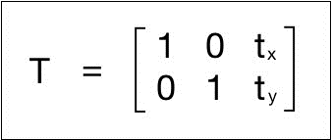
TRANSLATION
Introduction:
Translation here is fairly similar to ‘Translation of axes’ that we learned in intermediate i.e moving the pixels of an image from one point to another. Translation can be done in many ways, but my approach was to take the initial pixel of any image (0,0) and move it to another position (x,y) while moving all the other pixels with it following their respective order.
Since I had the basic picture of what was supposed to be done, I started by taking input x and y which will be the new starting coordinates of our translated image.
Math Behind The Code :-
To understand the preceding code, we need to understand how warping works. Translation basically means that we are shifting the image by adding/subtracting the X and Y coordinates. In order to do this, we need to create a transformation matrix, as shown as follows:

Slide 21

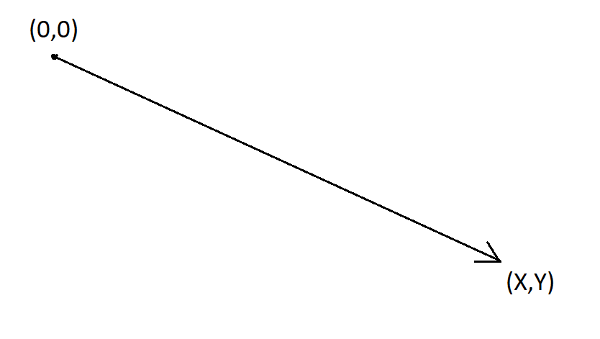
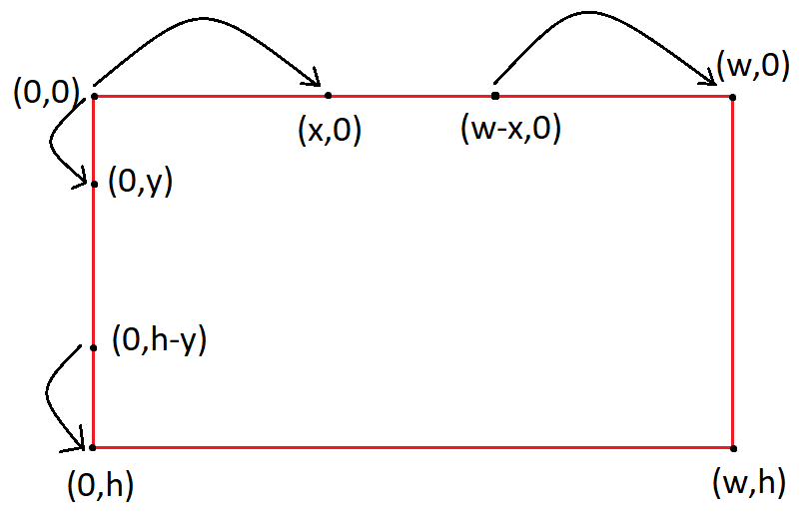
For simplicity, let us consider a single channel binary image
The pixel intensity at location
is given by
Note for a binary image
can take a value of 0 or 1.
The simplest kind of moment we can define is given below
Translating a point from (0,0) to (X,Y)
Translating each pixel in an Image: ‘x’ pixels rightwards and ‘y’ pixels downwards

Slide 22


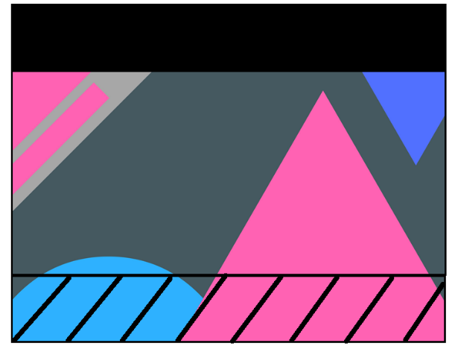


LIVE Translation of an Image:
1.Original Image
2. Translation in X axis
3. Translation in Y axis
4. Translation in both X axis and Y axis.

Slide 23
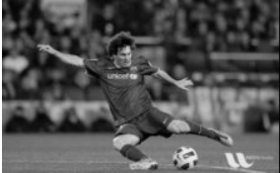


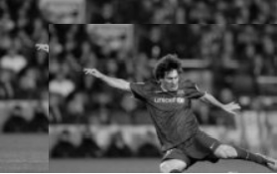
Code Approach :Original Image
Here w and h are the width and height of the input image respectively which are obtained by
Then I wrote a for loop in order to access and move every pixel in a particular range.
Intermediate Image

Slide 24
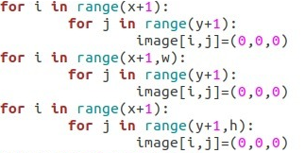
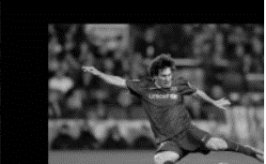
After moving all the pixels to the desired locations, we faced another problem as the translated image and the old image were kind of overlapping so we decided to color the old image to black which was partly being revealed.
For which we wrote the following for loops which are pretty much easy to understand…
Original Image vs. Translated Image

Slide 25
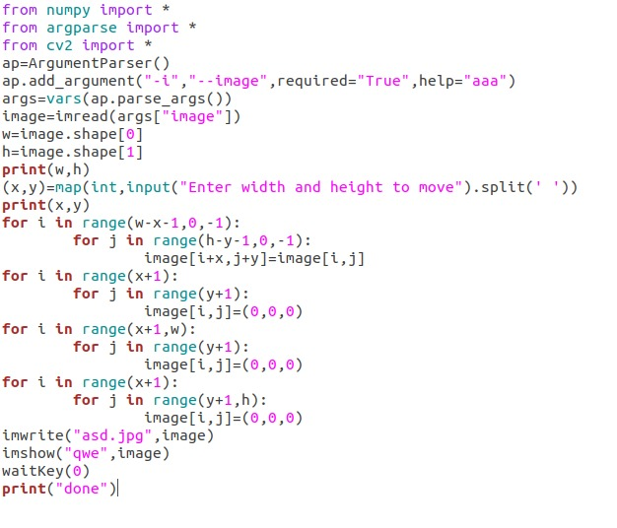
Entire Code:
Problems Faced:
The main problem we faced was during the execution of the program as our image went out of bounds on several occasions, other than that there weren’t many problems we faced.
Citations Referred :
Docs.opencv.org

Slide 26
CROPPING
Introduction:
Cropping is basically removing the unwanted pixels in an image. This can be done by taking a required pixel grid whose size is as required after cropping.
Explanation:
Libraries I used in this code are “matplotlib”, “numpy”.
“matplotlib” is an amazing visualization library in python for 2D plots of arrays.
“numpy” provides fast and efficient operations on arrays of homogeneous data.
“imread” is a function used to read an image, “imsave( )” is a function used to save an image. “waitkey( )” function is used to introduce a delay of ‘n’ milliseconds and used for keyboard input from the user.
Math Behind The Code:
Generally, during cropping of an image the area of interest is been taken out by using cropping operation and hence the size of the image remains the same. Changing the image size means scaling the whole image (or just a selected region) up or down.
Resizing changes the dimensions of the image, which usually affects the file size (and, thereby, image quality). Cropping always involves cutting away part of the original image and results in some of the pixels being discarded.

Slide 27
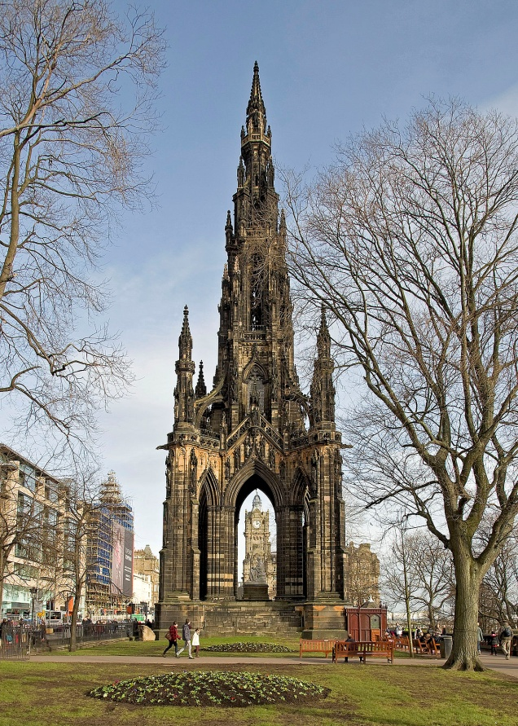
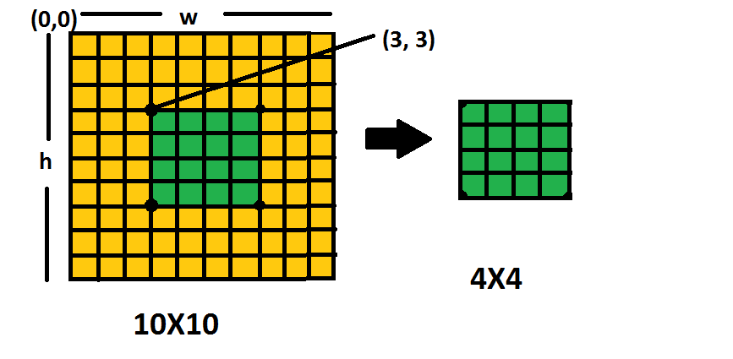
(0,height)
(0,0)
(width,0)
Image considered with co-ordinate axes representation.
Pictorial representation:

Slide 28
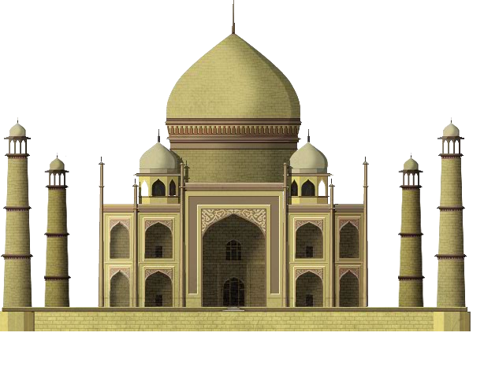
Code Approach:
Consider an image of size 10x10 pixel and if we require to crop only the center of the image with 4x4 pixel then collect values from (10-4)/2 starting from 3,3 upto 4th pixel in x,y directions.
Original image:
The extended name assigned to the image is “picture.png” which is obtained by
m=img.imread(“picture.png”)
Here, w and h are width and height of the input image respectively which are declared as follows
w,h=m.shape[:2]
The inputs for cropped image are given as
xnew=int(w*1/4)
ynew=int(h*1/4)
For required image size after cropping and printing width and height of original image
newimage=npy.zeros([xnew,ynew,4])

Slide 29
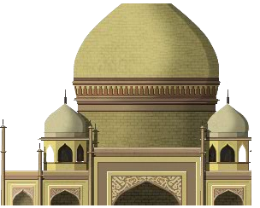
Then for loop is considered in order to access and move every pixel in a particular range. Another for loop is considered in order to apply cropping operation starting from 100x100 pixel to any desired pixel
for i in range of (1,xnew):
for j in range of (1,ynew):
newimage[i,j]=m[100+i,100+j]
Cropped image:
Entire Code:
import matplotlib.image as img
import numpy as npy
m = img.imread("taj.png")
w, h = m.shape[:2]
xnew = int(w * 1 / 4)
ynew = int(h * 1 / 4)
newimage = npy.zeros([xNew, yNew, 4])
print(w)
print(h)
for i in range(1, xNew):

Slide 30
for j in range(1, yNew):
newimage[i, j]= m[100 + i, 100 + j]
img.imsave('cropped.png', newimage)
The extended name assigned to the cropped image is “cropped.png” as mentioned above.

Slide 31




ROTATION
Introduction:
Rotation in CV is nothing but rotation of an image over an axis which basically passes through the center of the image. Here we take angle as an input from the user through which the image is then rotated and displayed by using the code given below.
Math Behind The Code:
is achieved by the transformation matrix of the form.
Rotation of an image for an angle
But OpenCV provides scaled rotation with adjustable center of rotation so that you can rotate at any location you prefer. Modified transformation matrix is given by
Where
Logic:
First we take the input of how much the image is to be rotated, which can be then used to rotate each individual pixel by substituting it in the above formula.
Since we can now rotate a pixel, we just have to find a way to rotate all the pixels in the image by writing a simple for loop.

Slide 32

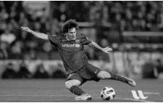
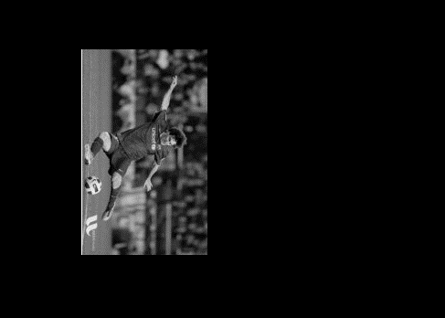
Then we copy these pixels into another canvas which is significantly bigger than the image so that it can accommodate the entire rotated image.
This canvas can be created by using the following format
After that the image is displayed by
Image Before Rotation:
Image After Rotation:

Slide 33
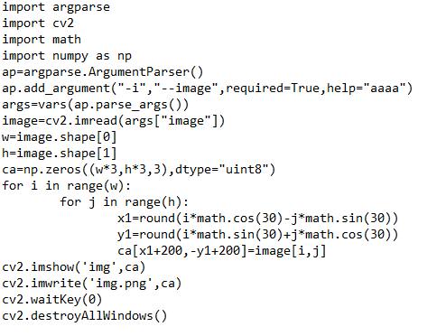
Source Code:

Slide 34
Future Scope:
Photographs shot on a digital camera are almost perfect. But then one can definitely have layers of creativity to make the same bunch of shots more appealing. This is where there is unlimited scope for image editing.
References :
https://www.tutorialspoint.com/python/index.htm https://www.youtube.com/watch?v=F2dVDHa421k resizing https://youtu.be/AqscP7rc8_M https://youtu.be/poY_nGzEEWM translation: https://www.varsitytutors.com/hotmath/hotmath_help/topics/transformation-of-graphs-using-matrices-translation rotation: https://en.wikipedia.org/wiki/Rotation_matrix kernel vector: http://setosa.io/ev/image-kernels/ Morphological transformations: https://youtu.be/P8JRZ4t7EOI
Conclusion:
A strong background of math is so helpful in all above programs and further projects based on image editing. Editing is a fashion nowadays. Hereby we conclude that this image editing library is useful in our day to day life and can be implemented all over the world.

